Slide 1
BISINDO Alphabets Classification using Convolutional Neural Network
Faiz Khansa Adrika
18/425516/PA/18408

Slide 2
Abstract

Slide 3
Abstract
Sign language recognition helps the deaf and the mute to communicate with others by translation
Aims to create an image classification model for Bahasa Isyarat Indonesia (BISINDO) alphabet signs with minimum 95% accuracy
The main value of this research is the preprocessing methods of Otsu Thresholding and Canny Edge Detection
The model will be developed using Convolutional Neural Network (CNN) using Keras library
The model’s early stopping was triggered on epoch number 26 after 2 hour and 10 minutes of training with the accuracy in the validation set of 97.93%.

Slide 4
Introduction

Slide 5
Introduction
Per 1 March 2020, 5% of the world population, --or around 466 million people-- has disabling hearing loss. Which the current data represent 432 million adults and 34 million children within the circle of disability (World Health Organization, 2020)
Sign language recognition (SLR) enables the user to conveniently translate gestures naturally and freely without the disturbance of devices, since it is moderately affected by small movements (He, 2019; Yang et al., 2009).
Notes:
Per 1 March 2020, 5% of the world population has disabling hearing loss (WHO)
SLR should be convenient and natural without disturbance of devices

Slide 6
Introduction
Bahasa Isyarat Indonesia or BISINDO for short, regarding the ease of cultural context is more natural than SIBI which use grammatical context of spoken Bahasa Indonesia (Gumelar et al., 2018; Handhika et al., 2018)
The research will create sign language recognition by image classification of preprocessed BISINDO alphabets using convolutional neural network (CNN).
The research mainly analyses the classification accuracy of edge detection and CNN implementation that will be further developed to sign language recognition system in the next research
Notes:
Bahasa Isyarat Indonesia or BISINDO is more natural than SIBI, by gumelar et al and handhika et al
The research will create sign language recognition by image classification of preprocessed BISINDO alphabets using convolutional neural network (CNN)
The research focus on the accuracy of the model that will be developed to slr

Slide 7
Related Works (Literature Review)

Slide 8
Related Works -1
Bin et al., (2019) in IEEE ICSIPA 2019 Malaysia, publicize their paper with the focus study of CNN in static ASL recognition. The research will capture image with smartphone camera. 24 ASL letters gestures captured and 200 images for each. CNN components built are one input layer, two cascaded convolutional layer including max pooling and dropout, one flattening layer, and fully connected layer with dropout, and output layer with softmax. The overall accuracy is 95%, but there is a fact that the alphabet W and X received 60% accuracy because of the sign gesture similarity. The limitation to the research is the noise reduction for segmentation and hand tracking, also an image occlusion.

Slide 9
Related Works -2
Harini et al., (2020) proposed a webcam based sign language translation system[9]. The image dataset captured from internal computer camera and pre-processed by converting to grayscale image and background substraction, also resized to 28*28 size for the ROI. CNN multilayers namely convolution, pooling, flattening, and connected layer also with ReLu activation function classifies the images into translations. The system able to translate sign language with the accuracy of 99.91%.

Slide 10
Related Works -3
Alom et al., (2019) also received a high percentage of accuracy by using CNN and SVM. 98.2% and 98.3% accuracy obtained for ASL dataset and SLD dataset, respectively[10]. The dataset are sign digits from ASL dataset and standard database (SLD). The ASL dataset filled with 700 image of 0-9 digits, 100 each, performed from 5 different individuals. The data are preprocessed using bilinear interpolation and noise removal by median filter. Trained Inception-v3 deep CNN architecture proposed for the feature extraction, transfer learning method to preserve weight value between layers also applied, and lastly the high level feature extracted by softmax. SVM was chosen for the classification for inseparable problem.

Slide 11
Methodology

Slide 12
Dataset
The dataset will be 26 BISINDO alphabets sign language. The sign language will be collected from public dataset in Kaggle by Riestiya Zain. The dataset is stored in the form of 3000x3000 pixel image dimension, but will be resized into 300x300 dimension.

Slide 13
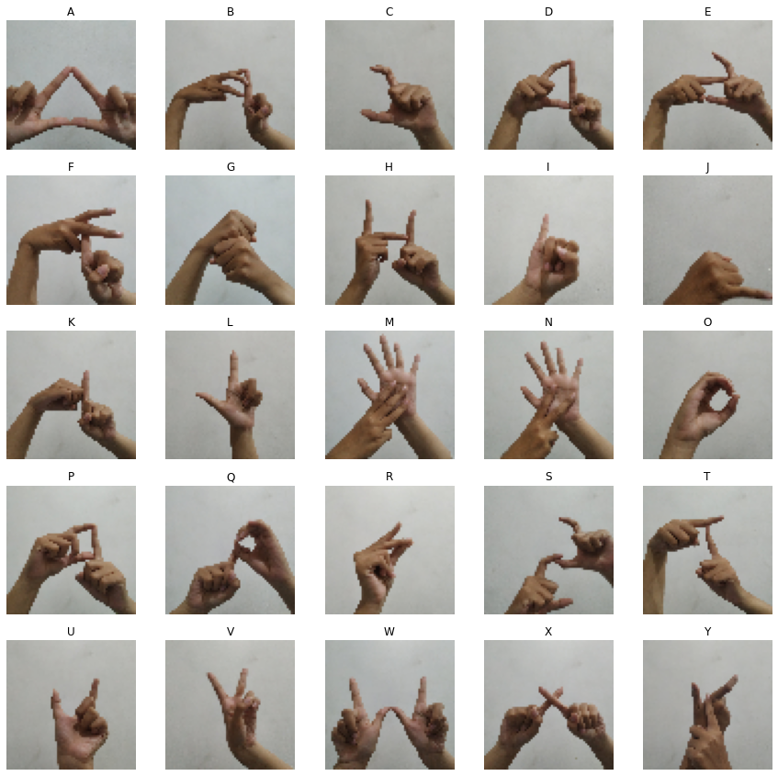
Dataset

Slide 14
Data Preprocessing
Gaussian Blurring is done by using 3x3 rectangular kernel. This method is adequate to remove Gaussian noise in an image.
Otsu Thresholding determines optimal global threshold value from the image histogram. The use of the Otsu thresholding is to find the optimal threshold value which later will be used to measure the threshold values parameter of the Canny Edge.
Canny Edge Detection focuses on only the existent edges in the picture. The upper threshold is equal to the threshold value from Otsu thresholding and the lower threshold takes 0.3 value ratio from the threshold value.
Morphological Transform is a simple operation that based on shape of image. we first use dilation to thicken the edge, then we add opening operation to reduce holes and details within the edges

Slide 15
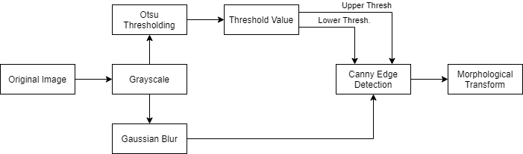
Data Preprocessing

Slide 16
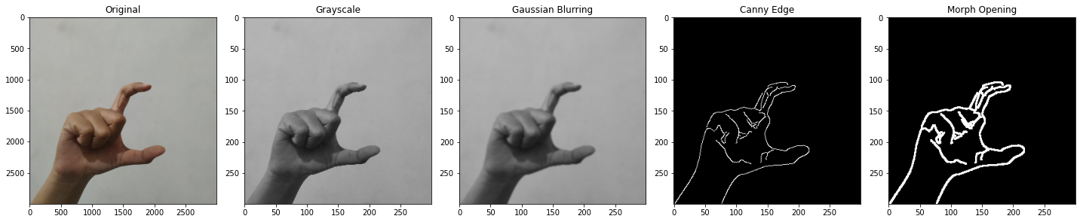
Data Preprocessing

Slide 17
Classification
The CNN model is specified using Sequential() of Keras library, creating the model by stacking linear layers of convolution functions
The activation functions that will be used are ReLU and Softmax algorithm
The optimizer used is ADAM optimizer with no further manual parameter on the learning rate.
The callback used to prevent overtraining is early stopping with monitor parameter of ‘val_loss’ and patience of five. It means that the model will stop earlier if the val_loss variable has not progressed (going smaller) in the last 5 epoch

Slide 18
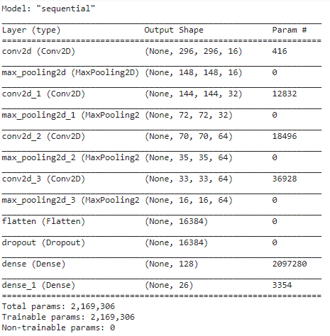
Classification

Slide 19
Result and Discussion

Slide 20
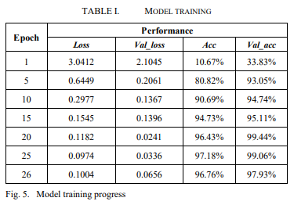
Model Fitting
The training went smoothly, the early stopping was triggered on epoch number 26 after 2 hour and 10 minutes of training with the accuracy in the validation set of 97.93%. The progress of the result are shown below:

Slide 21
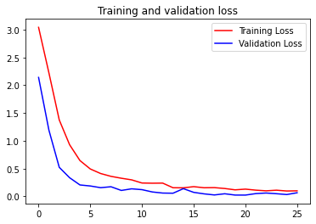
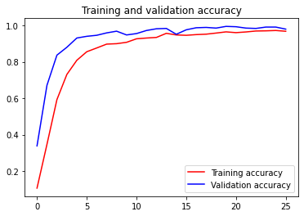
Model Fitting

Slide 22
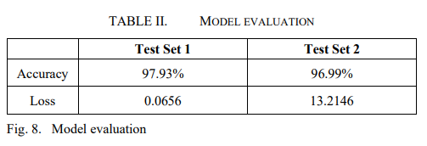
Model Evaluation
The model evaluation was conducted using two test dataset with difference in preprocessing. The first test set applies normalization which divides the pixel value by 255.0 into a float value between 0 and 1 and the second is without the normalization

Slide 23
Conclusion and Future Work

Slide 24
Conclusion
Preprocessing in SLR is vital, it could eliminate the chance of common problems such as lighting, clothing, and background issues.
The importance of preprocessing:
Blurring, will reduce noise that could affect the model’s feature extraction
Thresholding, simplify the pixelation by segmenting the background and foreground as binary image or just simply use the threshold value for edge detection
Edge detection, highlighting the object’s main area and increase the feature highlighting, its also important in object detection.

Slide 25
Future Work
Even though the research achieves a good result, there are more room to grow through this classification. From here we can further develop a sign language recognition system using object detection based on the model. The sign language recognition system can also be implemented in mobile devices due to the light sized-model and the flexibility in tensorflow and keras’ model export

Slide 26
Thank You

Slide 27
References
S. He, “Research of a Sign Language Translation System Based on Deep Learning,” in Proceedings - 2019 International Conference on Artificial Intelligence and Advanced Manufacturing, AIAM 2019, Oct. 2019, pp. 392–396. doi: 10.1109/AIAM48774.2019.00083.
World Health Organization, “Deafness and hearing loss,” Mar. 01, 2020. https://www.who.int/newsroom/fact-sheets/detail/deafness-and-hearing-loss (accessed Oct. 14, 2020).
T. Handhika, R. I. M. Zen, Murni, D. P. Lestari, and I. Sari, “Gesture recognition for Indonesian Sign Language (BISINDO),” in Journal of Physics: Conference Series, Jun. 2018, vol. 1028, no. 1. doi: 10.1088/1742-6596/1028/1/012173.
A. Riadi and P. Aditia, “Illustrated Book of Indonesian Sign Language for Deaf Children,” Dec. 2017.
G. A. Rao, K. Syamala, P. V. V. Kishore, and A. S. C. S. Sastry, “Deep convolutional neural networks for sign language recognition,” in 2018 Conference on Signal Processing And Communication Engineering Systems, SPACES 2018, Mar. 2018, vol. 2018-January, pp. 194–197. doi: 10.1109/SPACES.2018.8316344.
H. D. Yang, S. Sclaroff, and S. W. Lee, “Sign language spotting with a threshold model based on conditional random fields,” IEEE Transactions on Pattern Analysis and Machine Intelligence, vol. 31, no. 7, pp. 1264–1277, 2009, doi: 10.1109/TPAMI.2008.172.
G. Gumelar, H. Hafiar, and P. Subekti, “Bahasa Isyarat Indonesia Sebagai Budaya Tuli Melalui Pemaknaan Anggota Gerakan Untuk Kesejahteraan Tuna Rungu,” INFORMASI, vol. 48, no. 1, p. 65, Jul. 2018, doi: 10.21831/informasi.v48i1.17727.
L. Y. Bin, G. Y. Huann, and L. K. Yun, “Study of Convolutional Neural Network in Recognizing Static American Sign Language,” in 2019 IEEE International Conference on Signal and Image Processing Applications (ICSIPA), Sep. 2019, pp. 41–45. doi: 10.1109/ICSIPA45851.2019.8977767.
R. Harini, R. Janani, S. Keerthana, S. Madhubala, and S. Venkatasubramanian, “Sign Language Translation,” in 2020 6th International Conference on Advanced Computing and Communication Systems, ICACCS 2020, Mar. 2020, pp. 883–886. doi: 10.1109/ICACCS48705.2020.9074370.
Md. S. Alom, Md. J. Hasan, and Md. F. Wahid, “Digit Recognition in Sign Language Based on Convolutional Neural Network and Support Vector Machine,” Dec. 2019. doi: 10.1109/STI47673.2019.9067999.
K. Bantupalli and Y. Xie, “American Sign Language Recognition using Deep Learning and Computer Vision,” in Proceedings - 2018 IEEE International Conference on Big Data, Big Data 2018, Jan. 2019, pp. 4896–4899. doi: 10.1109/BigData.2018.8622141.
. Makarov, N. Veldyaykin, M. Chertkov, and A. Pokoev, “Russian Sign Language Dactyl Recognition,” in 2019 42nd International Conference on Telecommunications and Signal Processing (TSP), Jul. 2019, pp. 726–729. doi: 10.1109/TSP.2019.8768868

